Slide 1
Search and Recover Photograph Evidence

Slide 2
Understanding Graphics File Formats

Slide 3
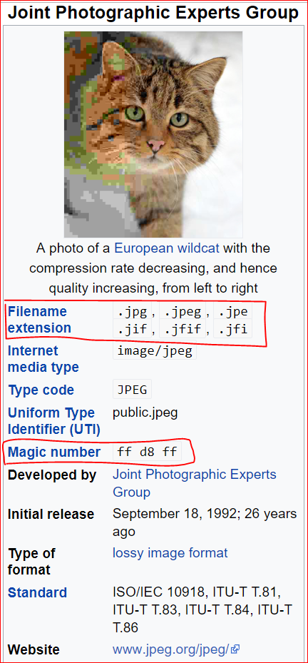
JPGE-Joint Photographic Experts Group
the name of the committee
is a commonly standard used method of lossy compression for digital photography.
only to a class of compression algorithms,
not to a specific file format.

Slide 4
The most common image file formats
JPEG/Exif (0xFFD8 FFE1): used by digital cameras and other photographic image capture devices.
JPEG/JFIF (0xFFD8 FFE0): : storing and transmitting photographic images on the World Wide Web.

Slide 5
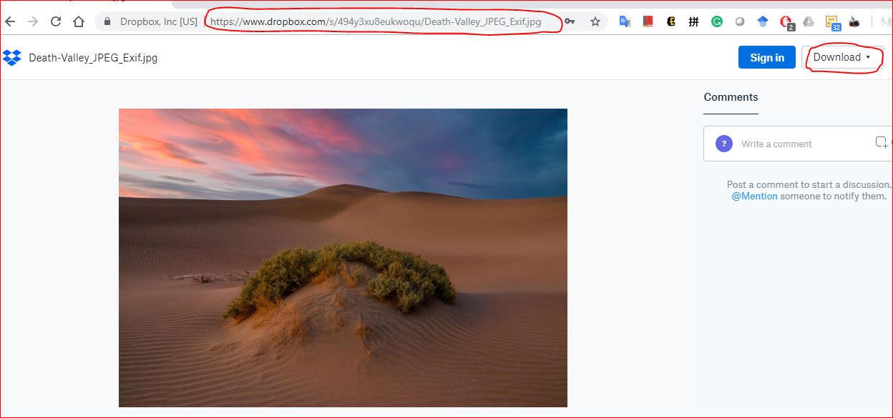
Check magic number
https://www.dropbox.com/s/494y3xu8eukwoqu/Death-Valley_JPEG_Exif.jpg
https://www.dropbox.com/s/qss9jzsa88gjvqs/Death-Valley-JPEG_JFIF.jpg
http://technologieshare.com/what-is-exif-data

Slide 6
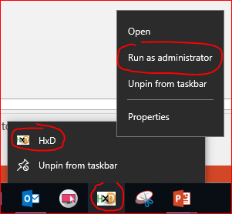
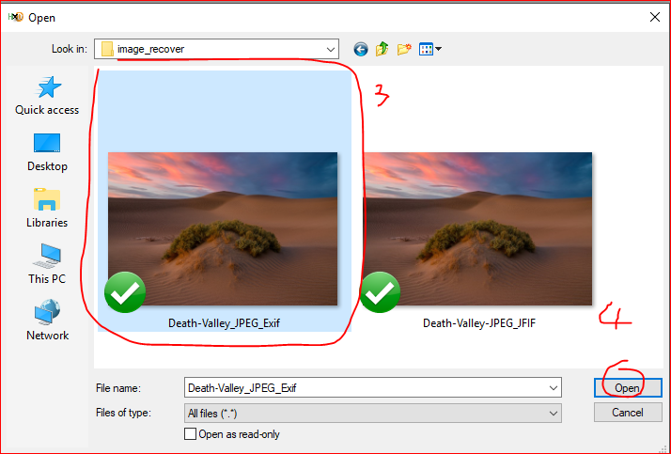
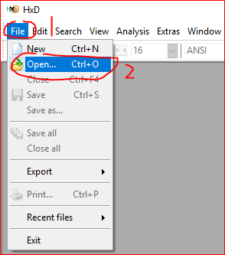

Slide 7
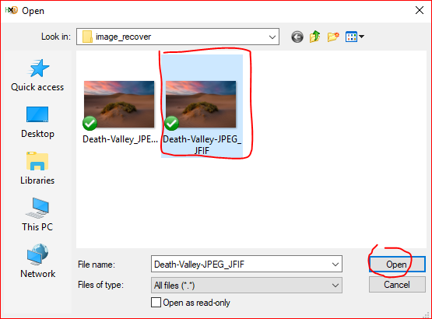
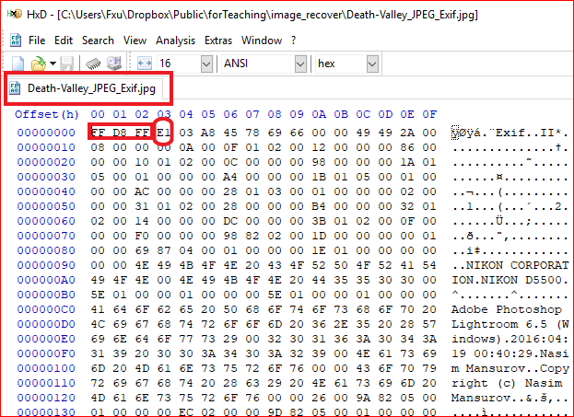
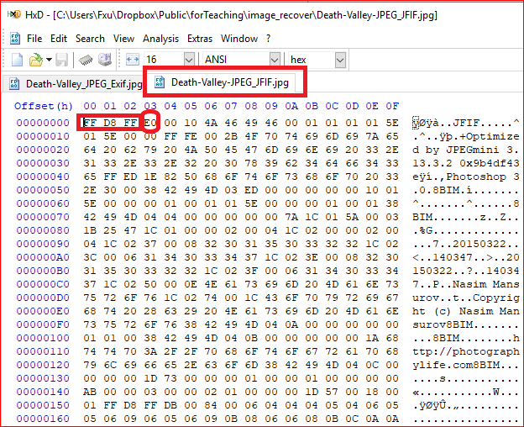

Slide 8
Repairing Damaged Headers

Slide 9
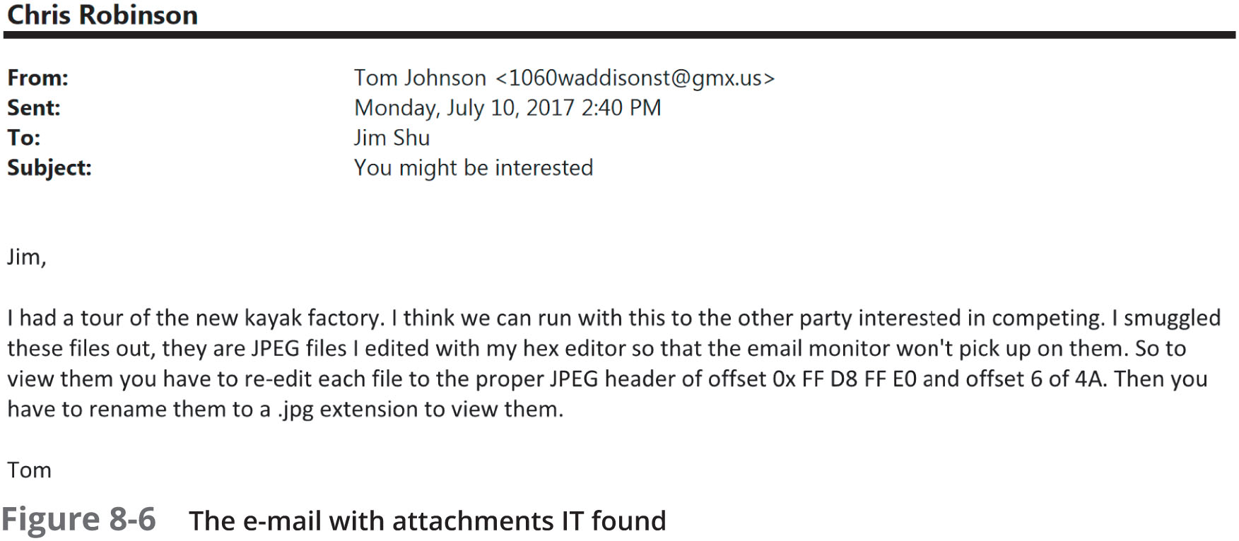
Case study
Investigate a possible intellectual property theft by a new employee of Superior Bicycles, Inc.

Slide 10
Understand the problem
“re-edit each file to the proper JPEG header of offset Ox FF D8 FF E0 and offset 6 of 4A”

Slide 11
Key Challenge
How to find these modified images?
We can research the string “FIF”

Slide 12
Key Challenge
How to find these modified images?
We can research the string “FIF”

Slide 15
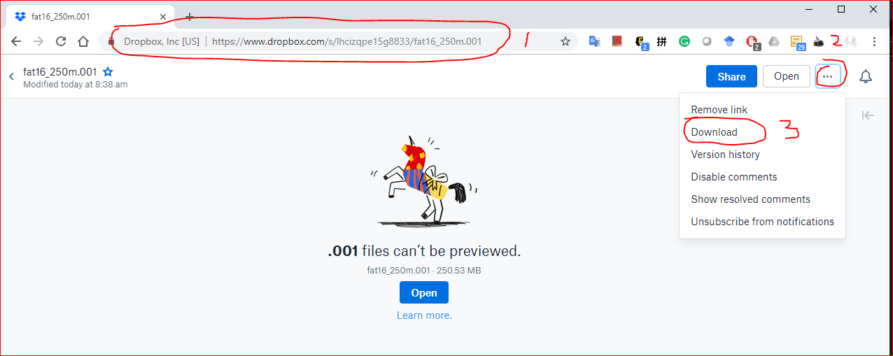
https://www.dropbox.com/s/a0lhsmzeh68wk1i/NTFS.001

Slide 16
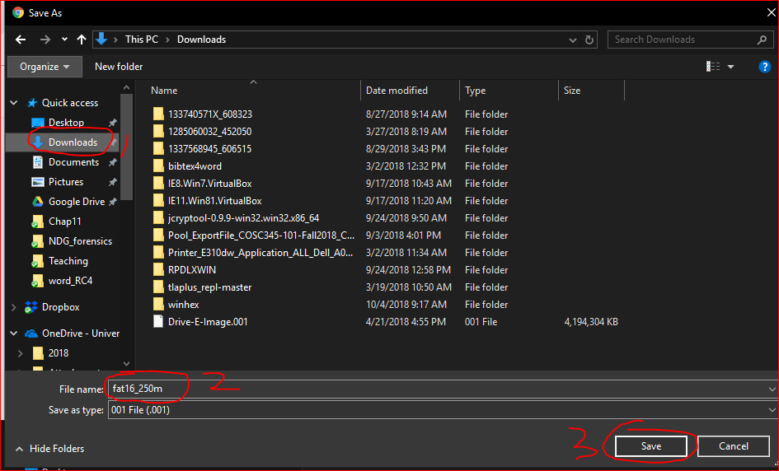

Slide 17
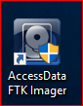
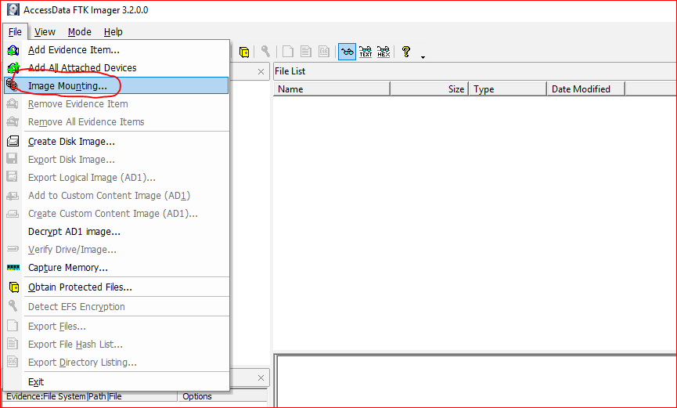

Slide 18
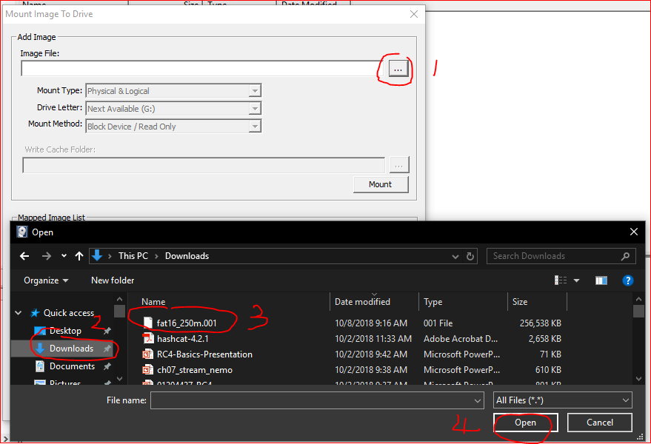

Slide 19
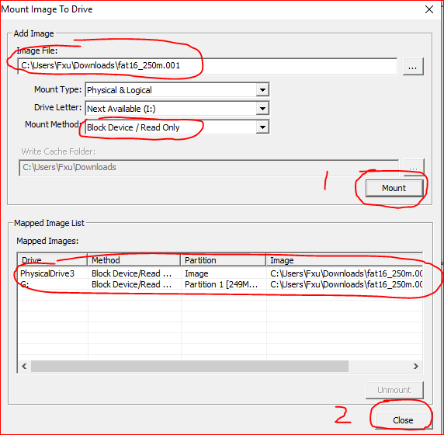
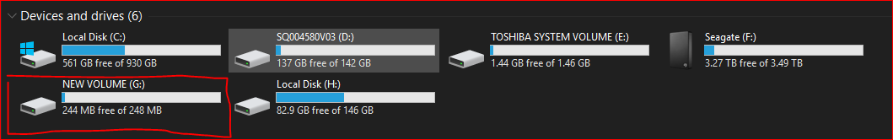

Slide 20
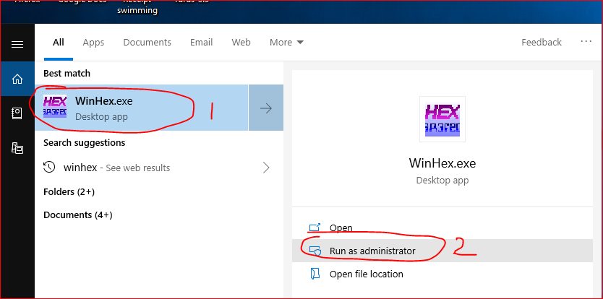
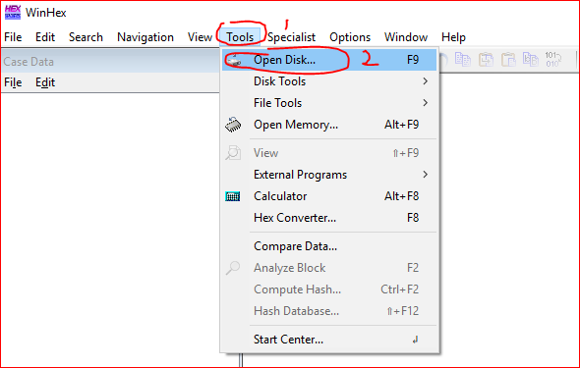

Slide 21
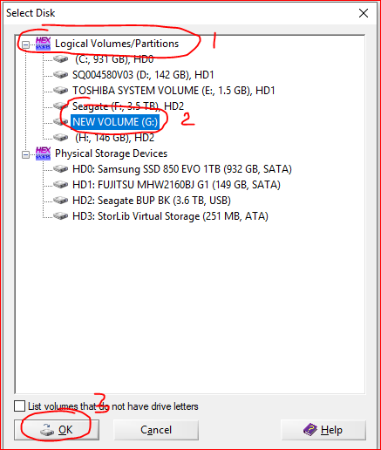

Slide 22
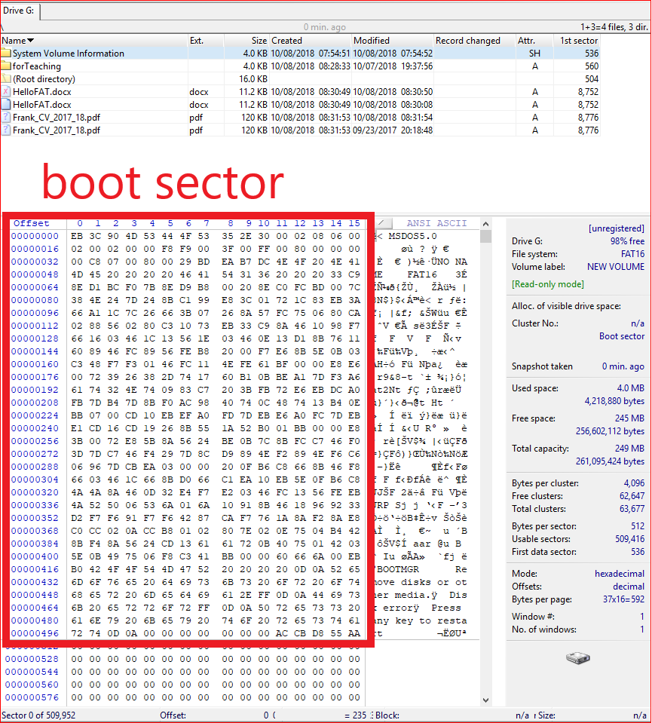

Slide 23
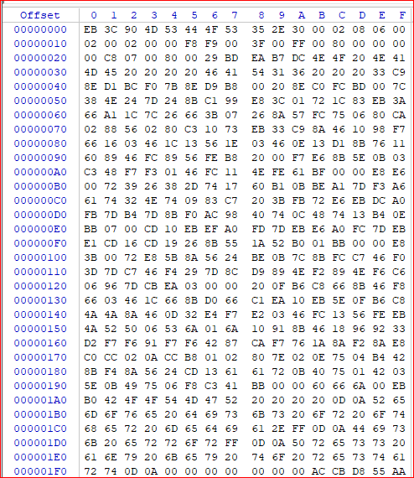

Slide 24
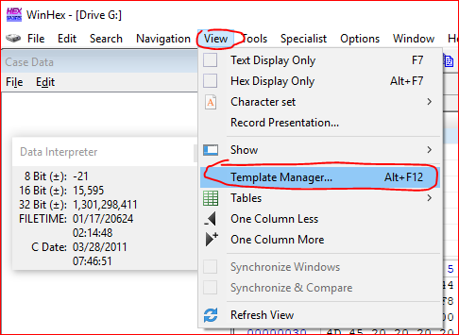
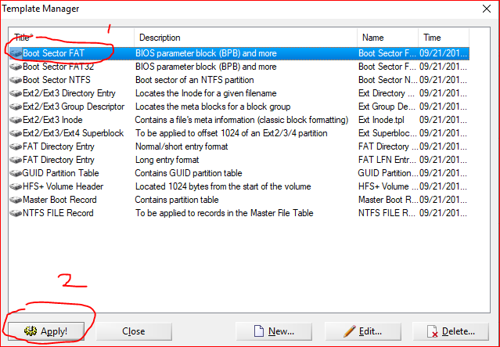

Slide 25
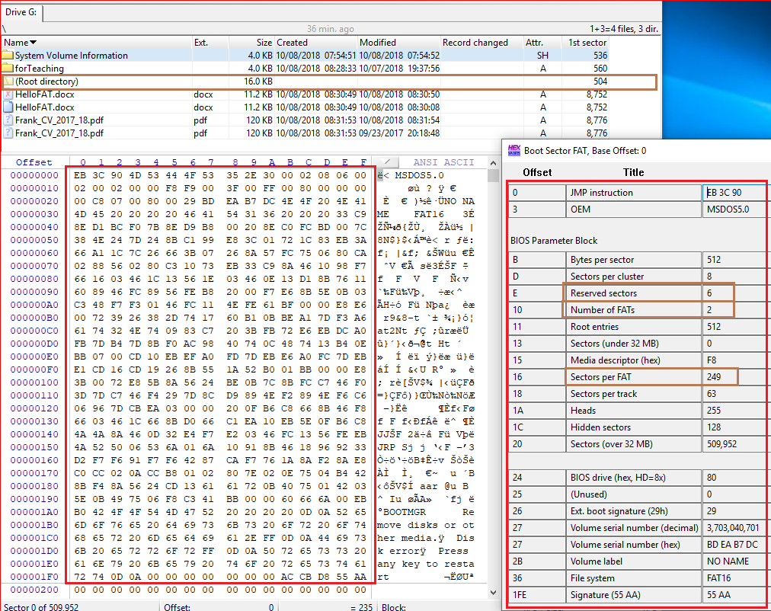
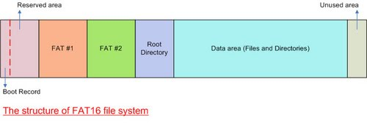
How to calculate the 1st sector of root directory?
1+6+249+249=505
We need minus 1 because of sector starts from 0

Slide 26
Root Directory

Slide 27
The Root Directory
The root directory contains an entry for each file whose name appears at the root (the top level) of the file system.
Each entry is 32 bytes (0x20) in size
a single block can contain 16 of them (=512/32).

Slide 28
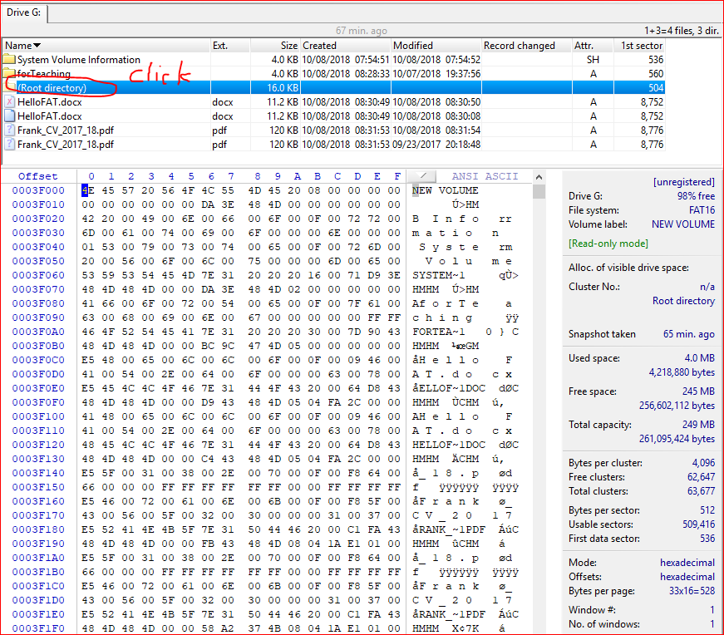

Slide 29
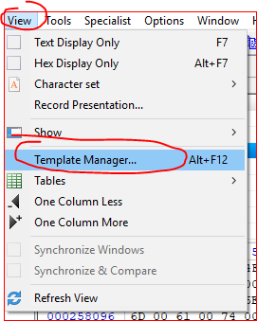
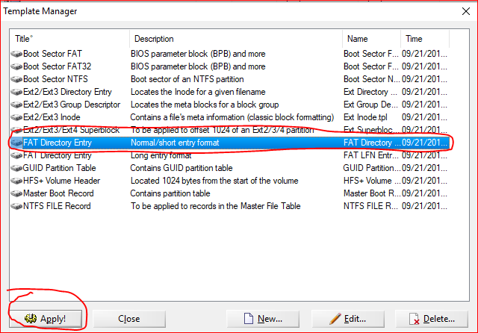

Slide 30
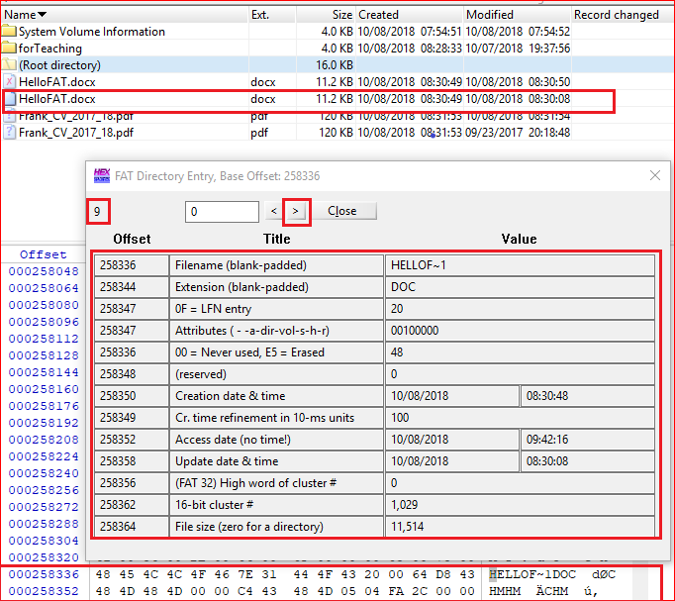
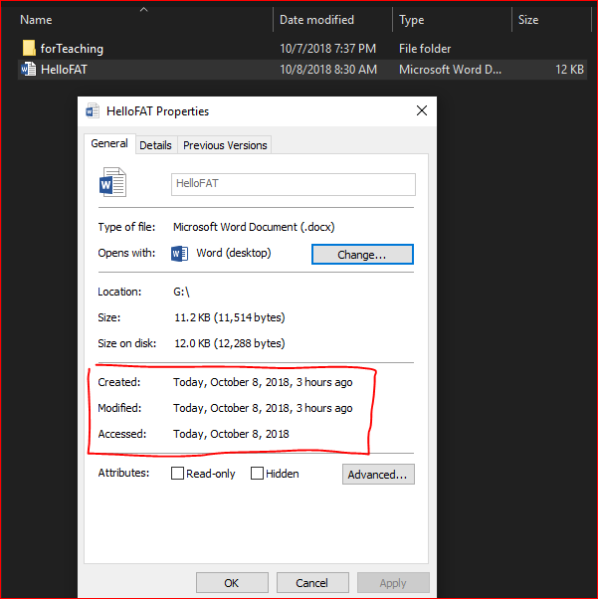

Slide 31
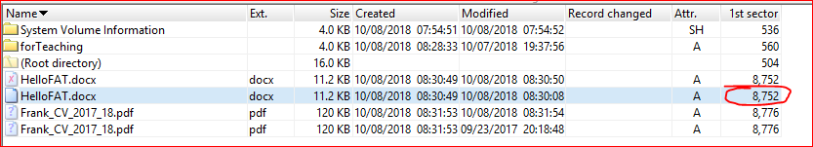
Why 8752

Slide 32
Boot sector (1) + Reserved sections (6) + FAT 1 (249) + FAT (249) + Root (32) + Cluster (1029 -2) *8

Slide 33
FAT 32

Slide 34
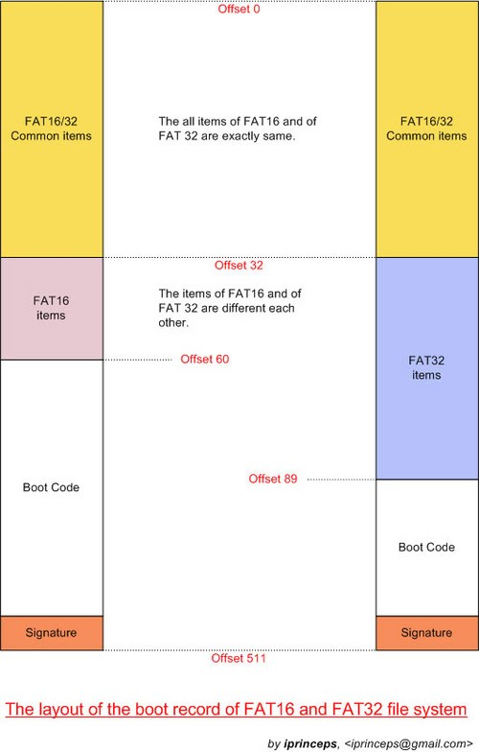

Slide 35
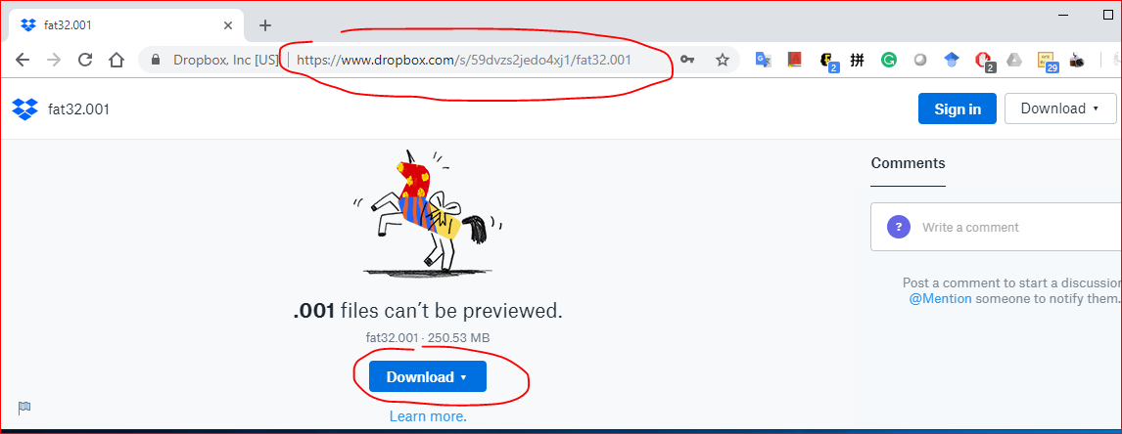
https://www.dropbox.com/s/59dvzs2jedo4xj1/fat32.001

Slide 36
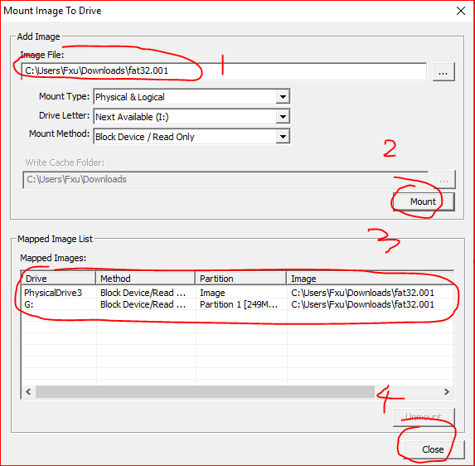
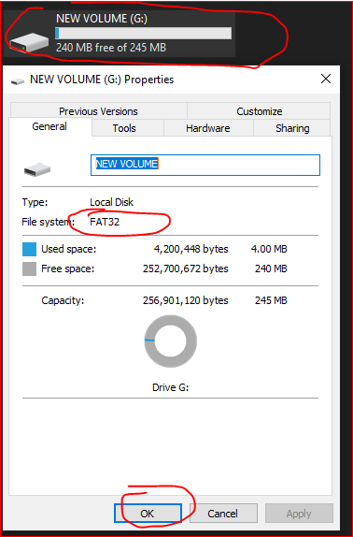

Slide 37
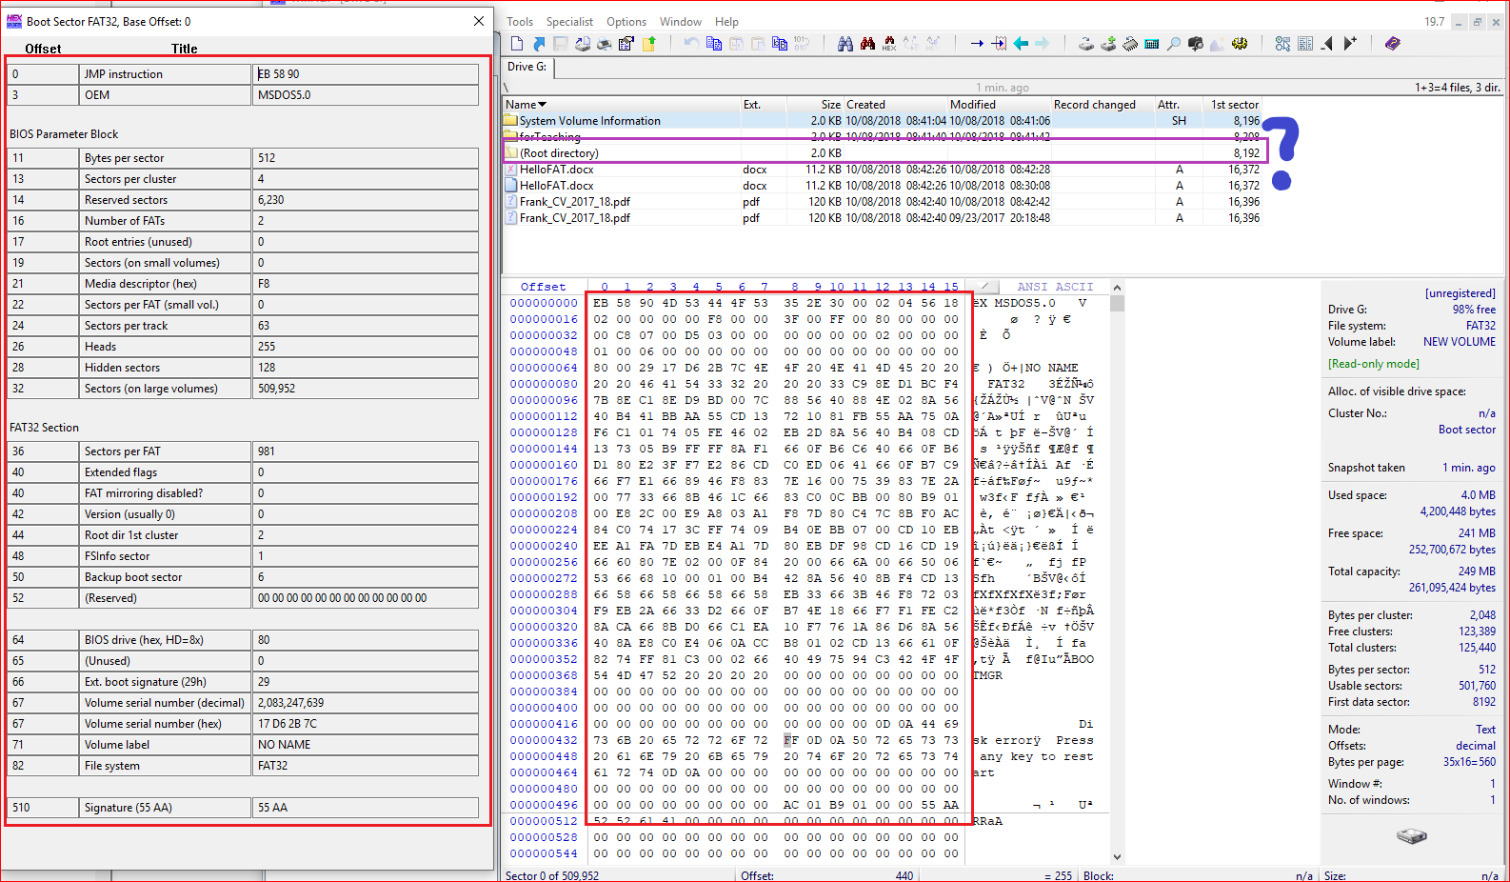
Boot sector (1) + Reserved sections (6230) + FAT 1 (981) + FAT2 (981)

Slide 38
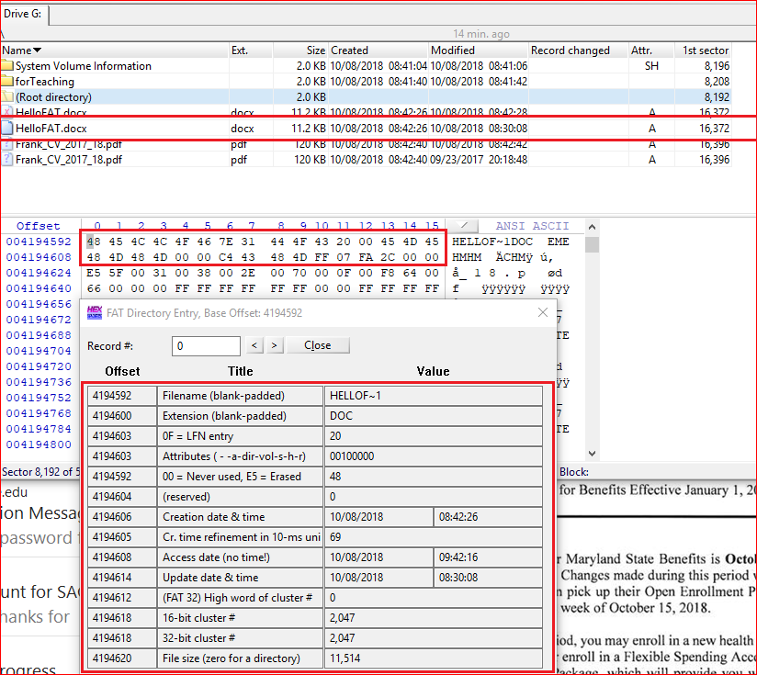

Slide 39
Reference
https://sites.google.com/site/iprinceps/Home/embedded-system-and-operating-systems/understanding-file-system

